Slide 1
Mini project
Vitalijs Tickovs

Slide 2
Dataset

Slide 3
Dataset
Weather
weathersit (4 distinct conditions)
temp (0 to 1)
atemp (0 to 1)
hum (0 to 1)
windspeed (0 to 1)
Time
- dteday date ( month/day/year)
- season (spring, summer, autums, winter)
- yr year (2011/2012)
- mnth (0 to 11)
- hr (0 to 23)
- holiday (0 or 1)
- weekday (0 to 6)
- workingday (0 or 1)
Target Variable
- casual
- registered
- cnt: casual + registered
Source: https://archive.ics.uci.edu/dataset/275/bike+sharing+dataset

Slide 4
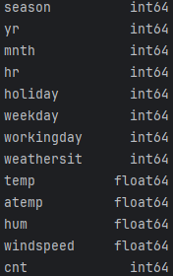
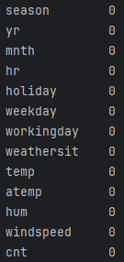
Dataset
Size: 17377 entries
2 duplicate entries
Variable Type Table
Nan value table

Slide 5
Explanatory Data analysis

Slide 6
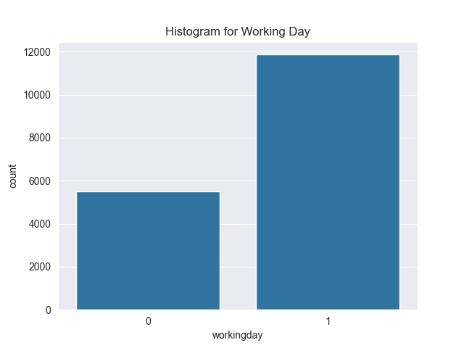
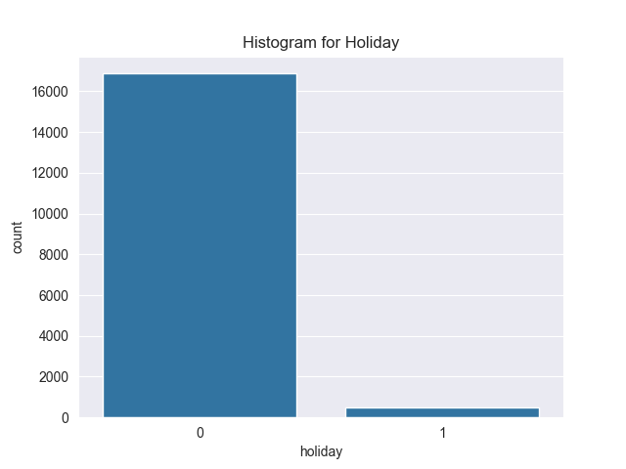
EDA

Slide 7
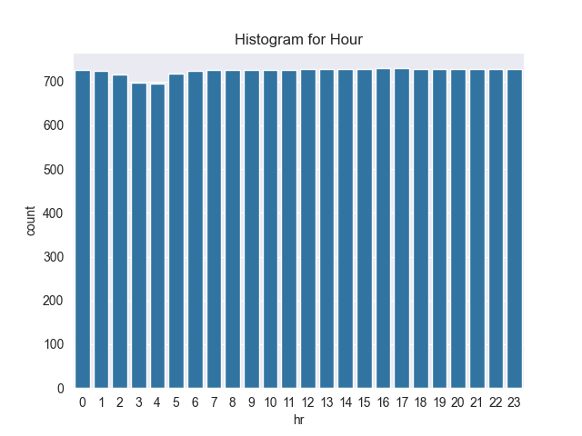
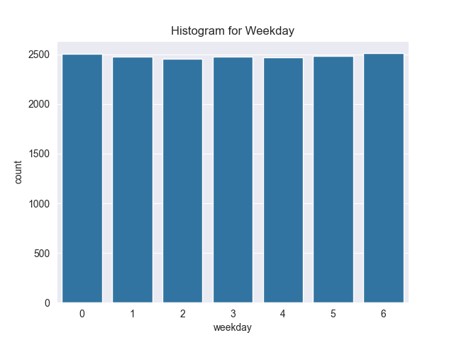
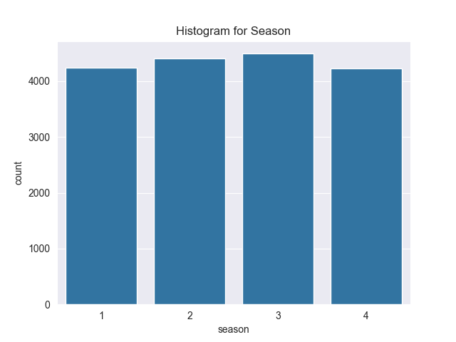
EDA

Slide 8
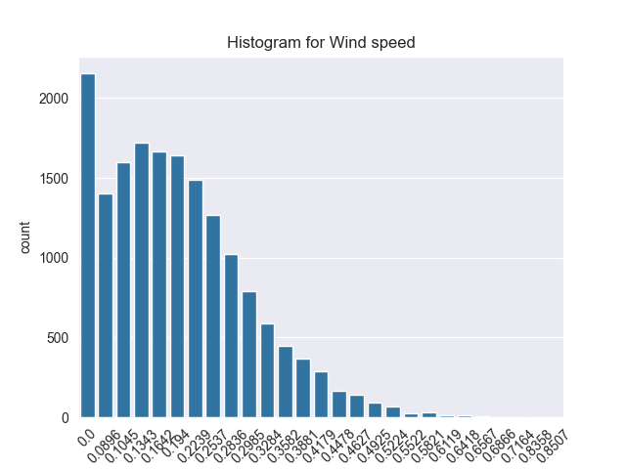
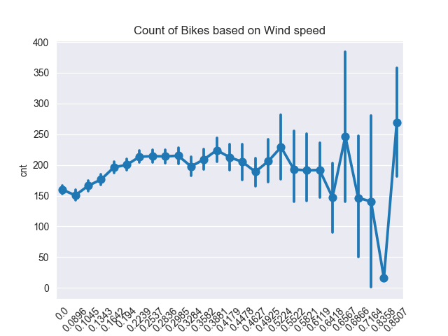
EDA

Slide 9
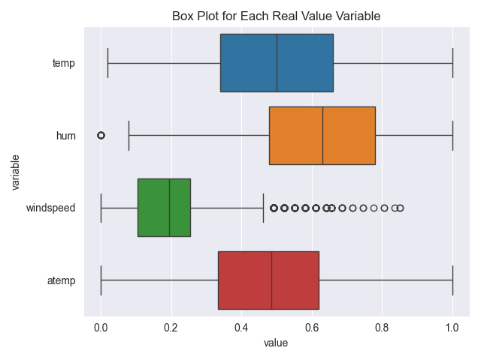
EDA

Slide 10
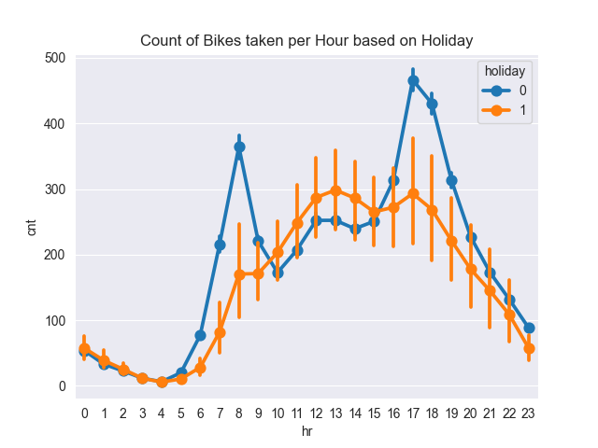
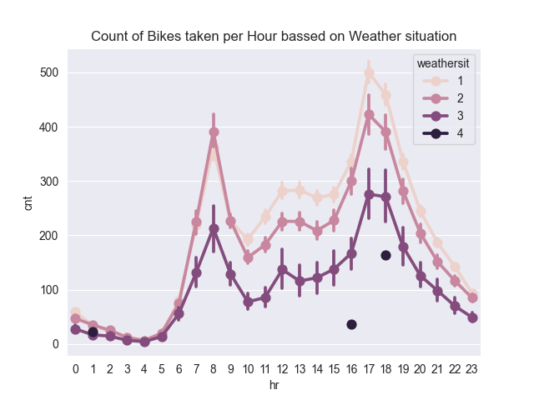
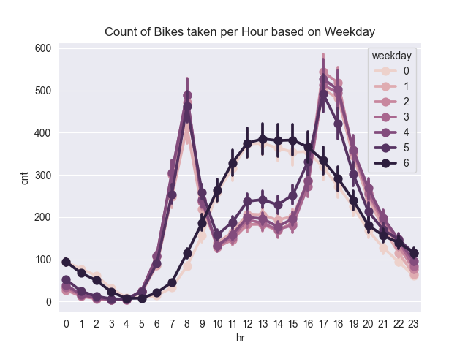
EDA

Slide 11
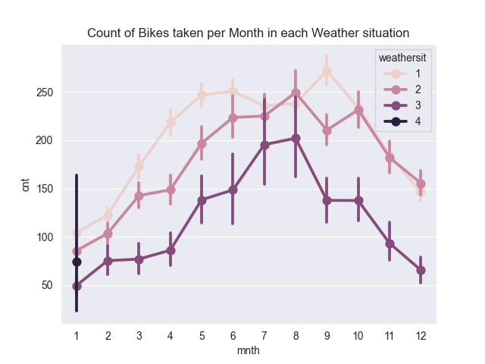
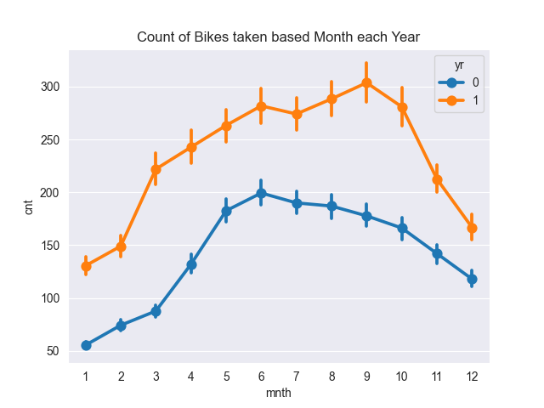
EDA

Slide 12
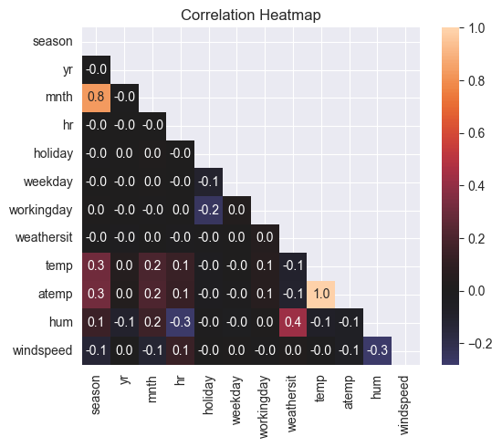
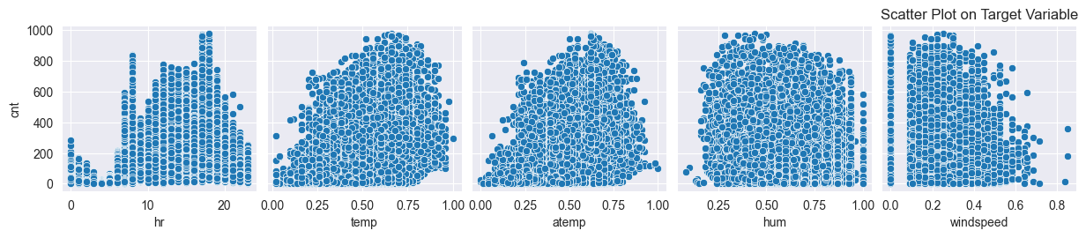
EDA

Slide 13
Model

Slide 14
Model Training
Linear Regression
Standardized Linear Regression
Regularized Linear Regression
Support Vector Machine
Random Forest
Neural Network
Train set: 80%
Test set: 20%

Slide 15
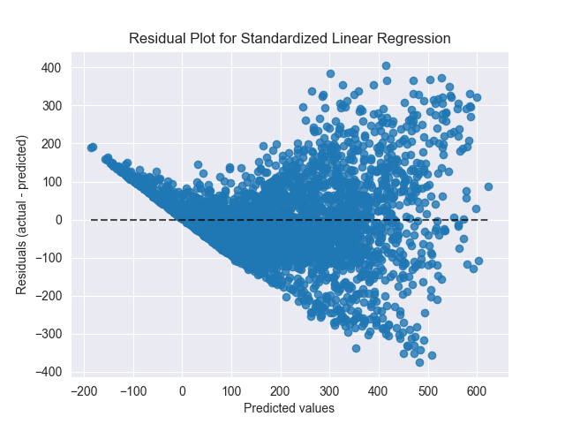
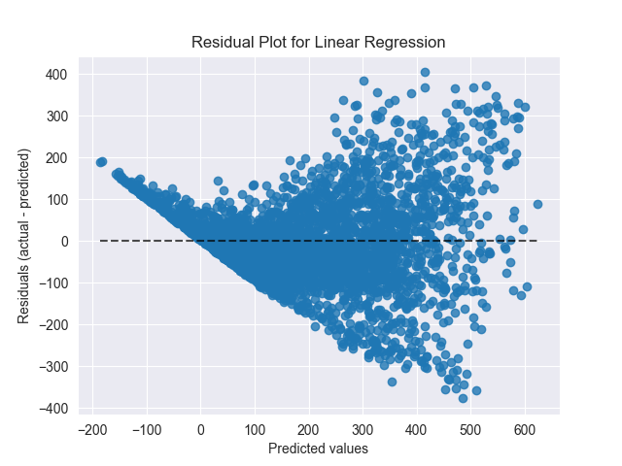

Linear Regression Performance
 | RMSE | R²
Linear Regression | 102.283 | 0.678
Standardized Regular Regression | 102.293 | 0.677
Regularized Regular Regression | 102.261 | 0.678

Slide 16
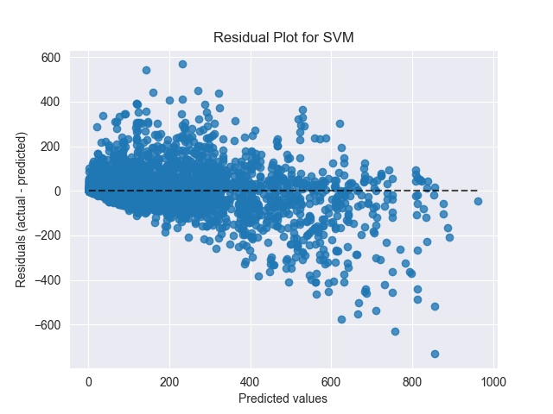
SVM Performance
 | RMSE | R²
SVM | 99.432 | 0.695

Slide 17
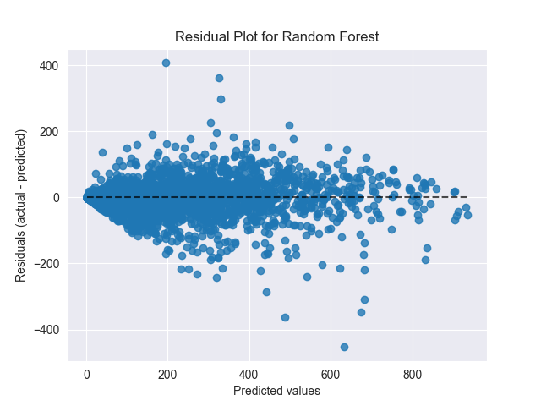
Random forest performance
 | RMSE | R²
Random Forest | 47.818 | 0.930

Slide 18
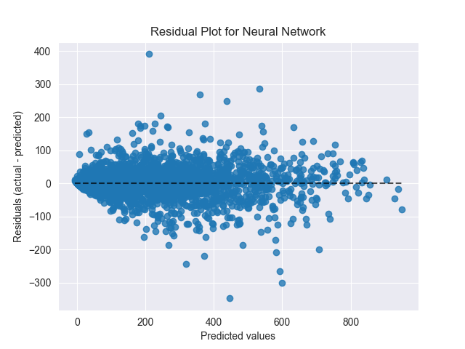
Neural network performance
 | RMSE | R²
Neural Network | 43.843 | 0.940

Slide 19
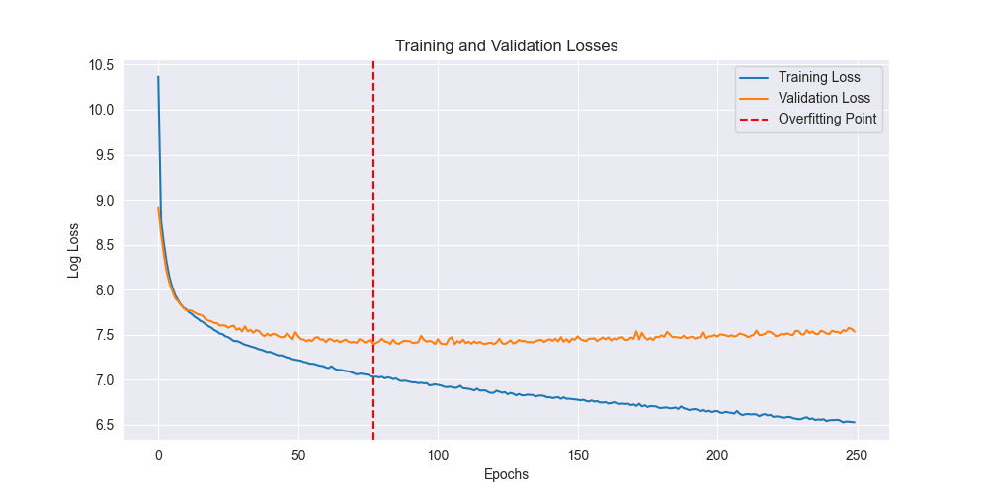
Neural network overfitting plot

Slide 20
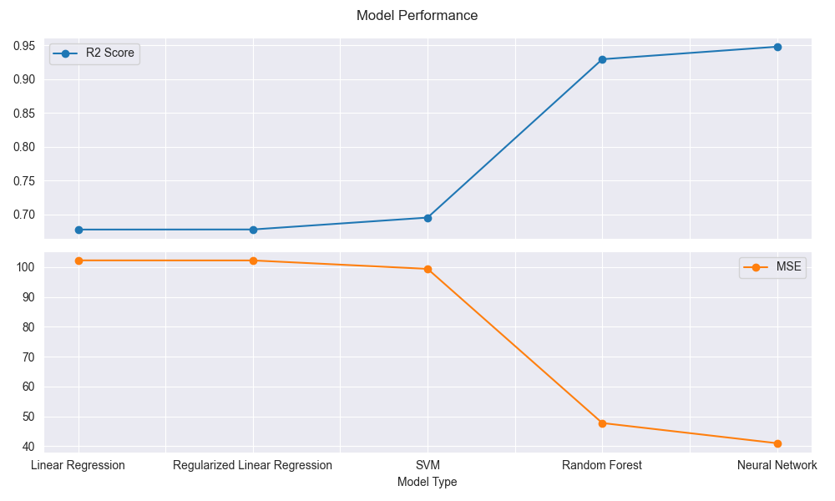
Model comparison

